Slide 1
YouTube Trending Video Analysis
Group 4: Naveena Pokala, Xiuwen, Riya Desai

Slide 2
Stage I&II

Slide 3
Objective
YouTube maintains a list of the top trending videos on the platform, to determine the year’s top-trending videos, YouTube uses a combination of factors including number of views, shares, comments and likes, trending date.
We use Kaggle Dataset https://www.kaggle.com/datasets/datasnaek/youtube-new?select=USvideos.csv .
This dataset was selected since it had around 40,950 observations and 16 features.
The objective is to perform a regression task to predict the number of days based on features: number of views, number of likes, dislikes and comments, category name received on its first day of release.

Slide 4
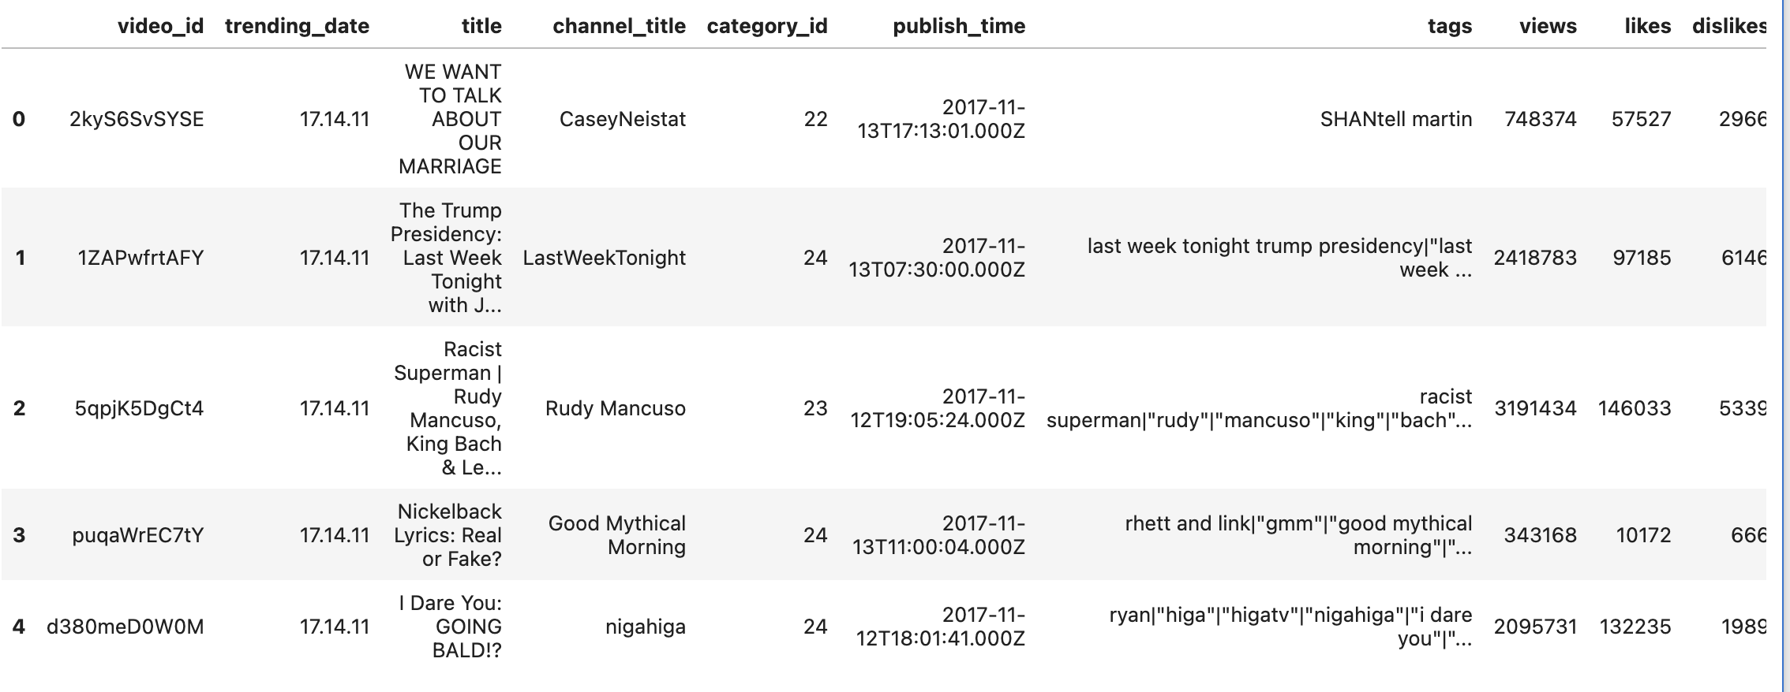
Data

Slide 5
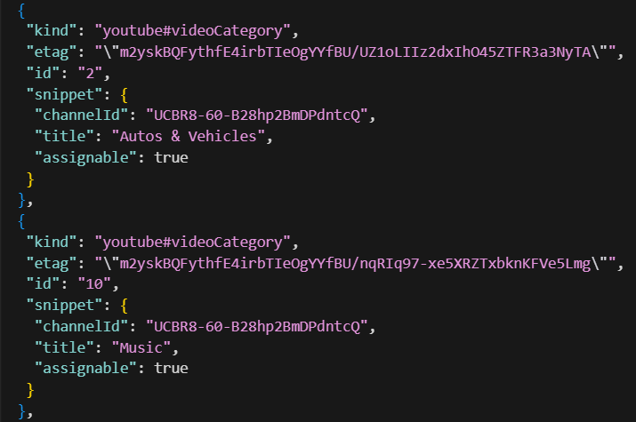
Preprocessing
For every unique video ID, keep the observation that the video first trends on, deleting the observations for the following days of the same video, creating the target variable days_trending
  Data after preprocessing: 6351 observations
  Features: views_day1, likes_day1, dislikes_day1, first trending date, category_name
Merged category names into DataFrame.

Slide 6
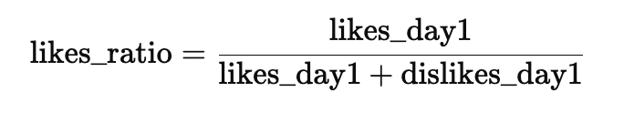
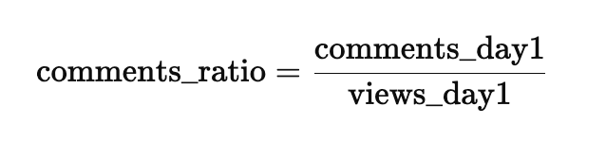
Feature Exploration
During this process, we created two features from the existing features i.e., likes_ratio and comments_ratio
The likes ratio is calculated as the proportion of likes to the total reactions, it measures how positively viewers reacted to a video on its first trending day.
The comments ratio is calculated as the number of comments divided by the total views on the first trending day. It tells us the level of audience engagement.

Slide 7
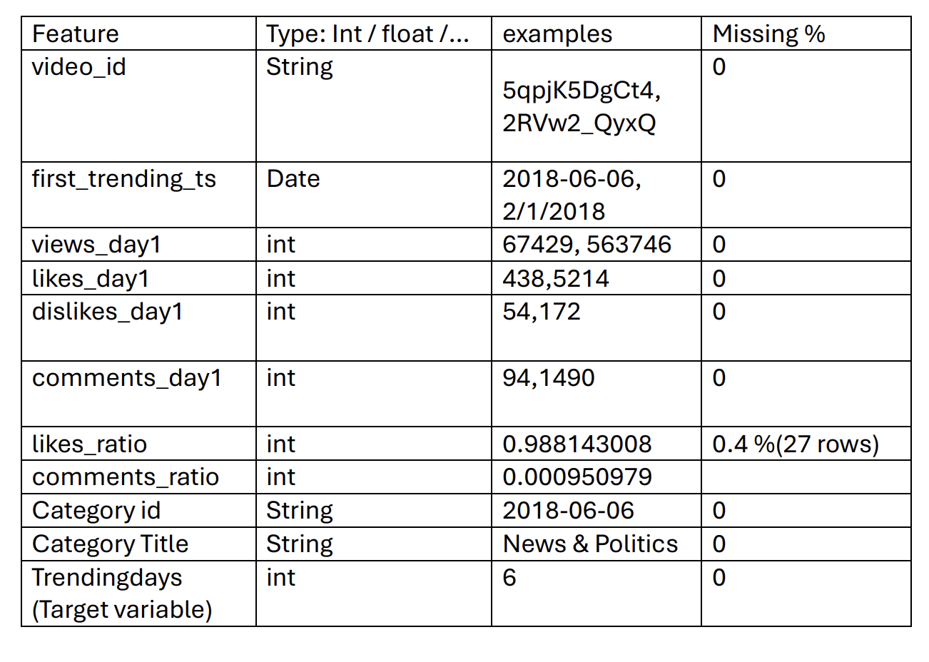
Missing Value Analysis
0

Slide 8
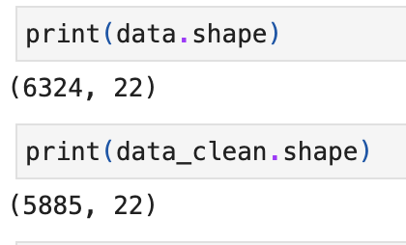
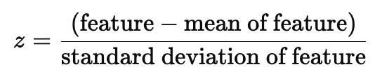
Outlier Analysis
Outlier Analysis are done using z-scores on the feature or log transformations of the feature
Z-scores< -3 or z-scores >3 are considered as outliers and dropped. Total 439 records have been dropped.

Slide 9
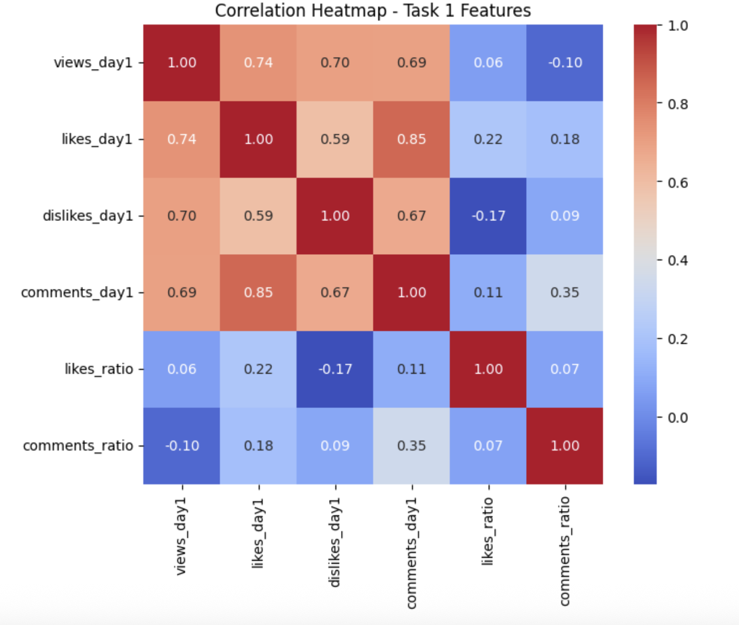
Correlation Analysis
Correlation Analysis is done by calculating correlation matrix and visualizing it using heatmap.

Slide 10
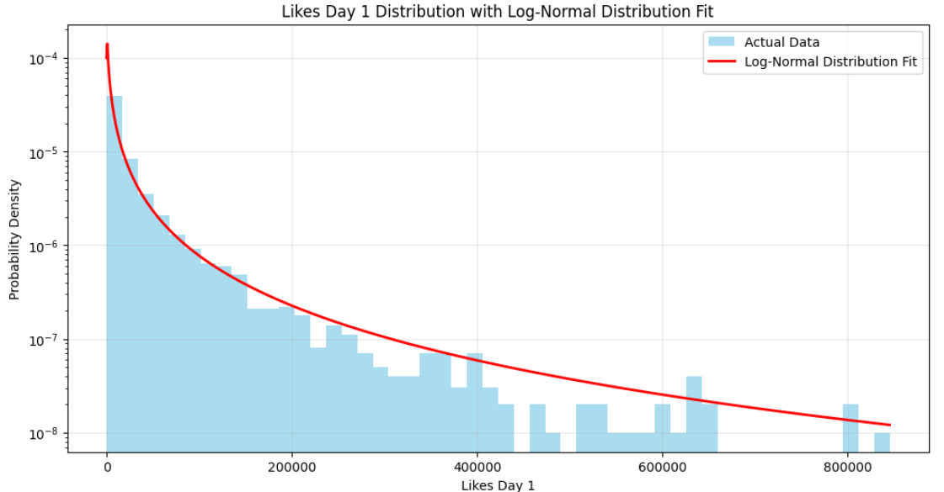
Distribution Fitting
Feature: likes_day1
Distribution: Lognormal Distribution
The data is highly right-skewed; taking the logarithm may approximate a normal distribution.

Slide 11
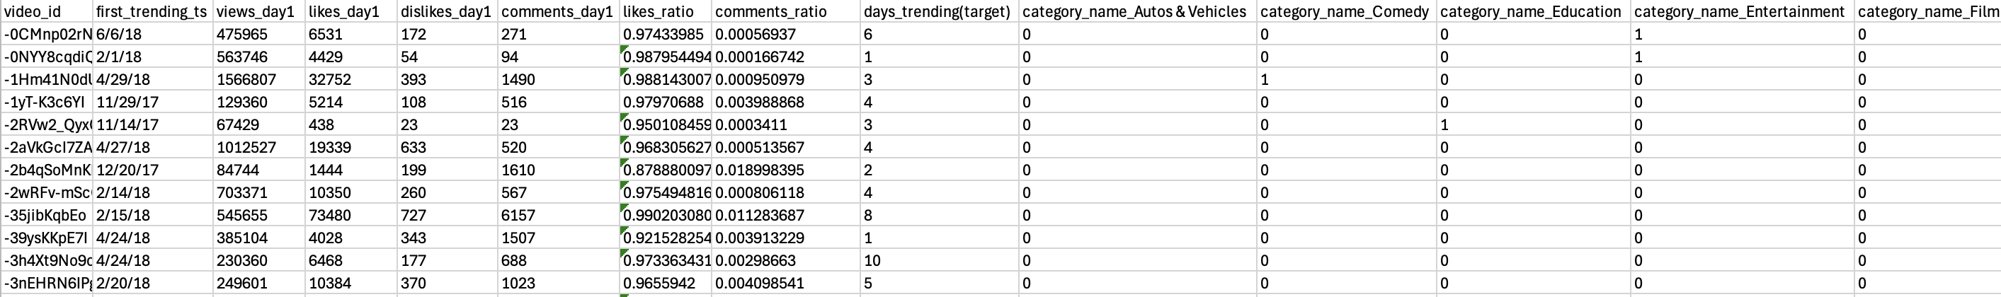
Final Dataset
One hot encoding the categorical variable. Consisting of 11 categories.

Slide 12
Hypothesis
Based on the data, we formulated 3 hypothesis questions.
Does a higher number of views on the first day lead to a higher likes ratio?
Videos with a higher comments ratio are likely to trend for a longer duration?
Different categories have significantly different average trending durations?

Slide 13
Stage III

Slide 14
Hypothesis Verification
Hypothesis Question : Does a higher number of views on the first day lead to a higher likes ratio?
For this hypothesis Pearson correlation was used. Pearson correlation test was used as both features are continuous.
correlation value: 0.043 and p-value: 0.0009.
This test gave p-value lower than the significance level of 0.05, proving that the null hypothesis H0 will be rejected.

Slide 15
Hypothesis Verification
Hypothesis Question : Videos with a higher comments ratio are likely to trend for a longer duration
Spearman Rank Correlation Test is the most appropriate statistical method because we are examining the relationship between two continuous variables, comments ratio and trending duration.
Spearman Correlation Test Results:
Test Statistic (ρ): 0.1703
P-value: 1.5584e-39
This test gave p-value lower than the significance level of 0.05,proving that the null hypothesis H0 will be rejected.

Slide 16
Hypothesis Verification
Hypothesis Question : Different categories have significantly different average trending durations?
Because we are comparing the means of a continuous variable (trending duration) across multiple categories, the right test is: One-Way ANOVA (Analysis of Variance) It checks if the mean trending durations differ significantly among categories.
F-statistic: 13.9511 and p-value: 1.37 × 10⁻³⁵.
This test gave p-value lower than the significance level of 0.05,proving that the null hypothesis H0 will be rejected.

Slide 17
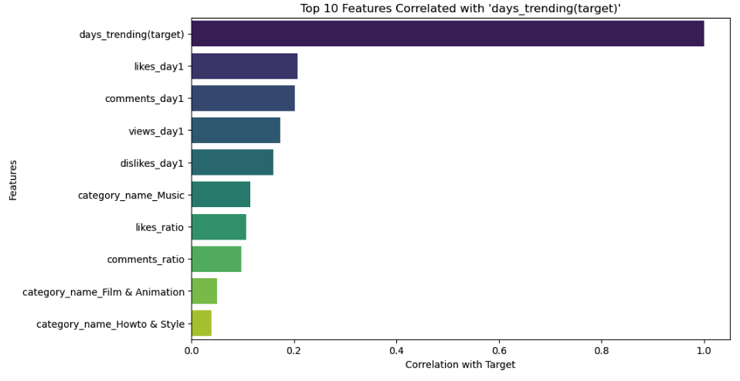
Feature Selection
To check what features were most aligned with the target variable we used Pearson correlation.

Slide 18
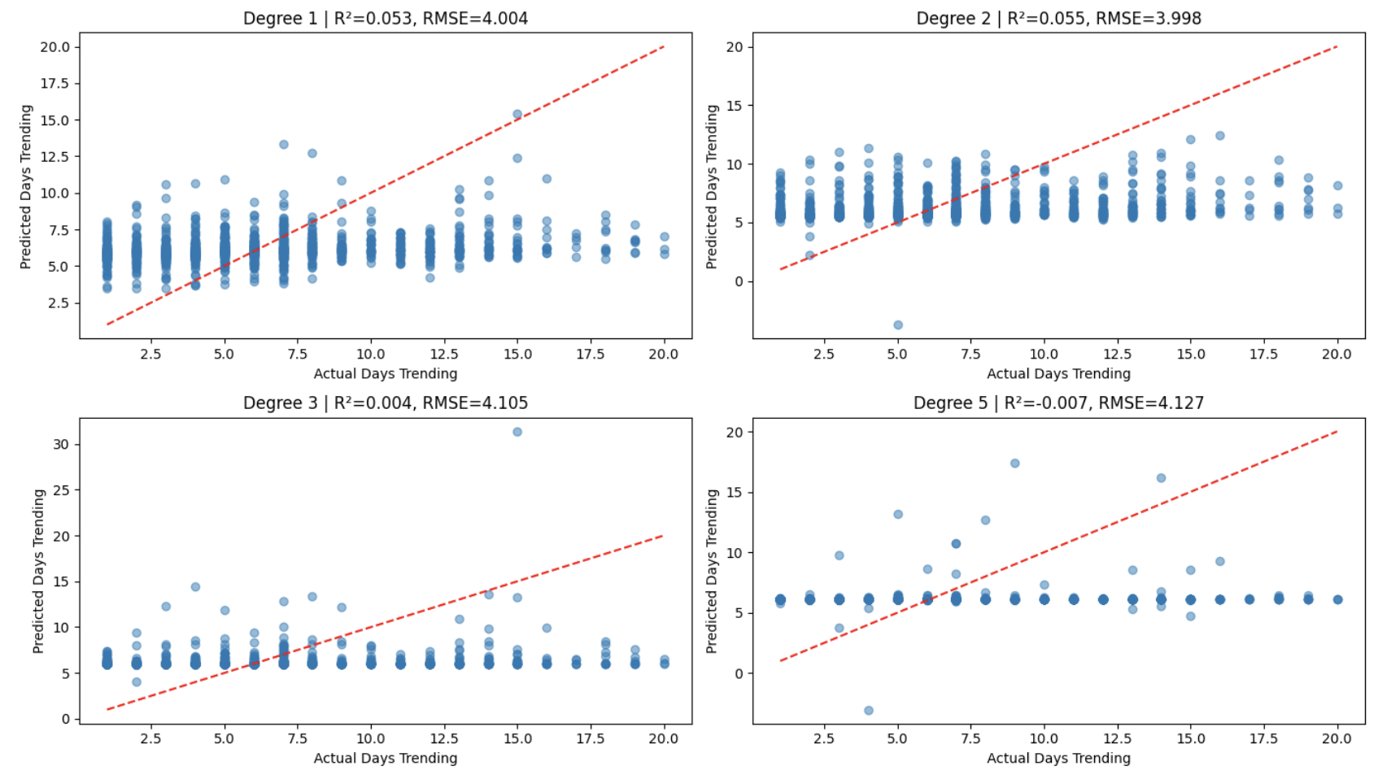
Machine Learning-Baseline
We modeled the model with different degrees like 1,2,3 and 5 and compared the performance.
Model Performance Summary:
Degree R² RMSE
1 0.052633 4.003865
2 0.055264 3.998301
3 0.004140 4.105060
5 -0.006596 4.127128

Slide 19
Decision Tree
The parameters used for this model are max depth and min sample split, defined as 5 and 20 respectively. This model was evaluated using R2 and MSE.
MSE : 16.2703, large prediction errors.
R2 Score : 0.0343, does not fit the data.
Feature Importance interpreted using Decision Tree.
Notes:
The model makes large prediction errors
A Mean Squared Error of 16.27 means the predicted values deviate significantly from the true values.
This suggests:
The tree is not capturing the underlying patterns well.
It may be overfitting to noise (common with trees that are not pruned).
Or the dataset may be too small / too complex for a tree to generalize.
⭐
2. Near-Zero R² (0.0343) → The model barely explains variability
R² = 0.0343 means:
The model explains only ~3% of the variance in the target.
A baseline model predicting the mean would almost perform the same.
This indicates:
The decision tree is not learning meaningful structure.
The features are not being used effectively.
In short, the model is almost as bad as random guessing.

Slide 20
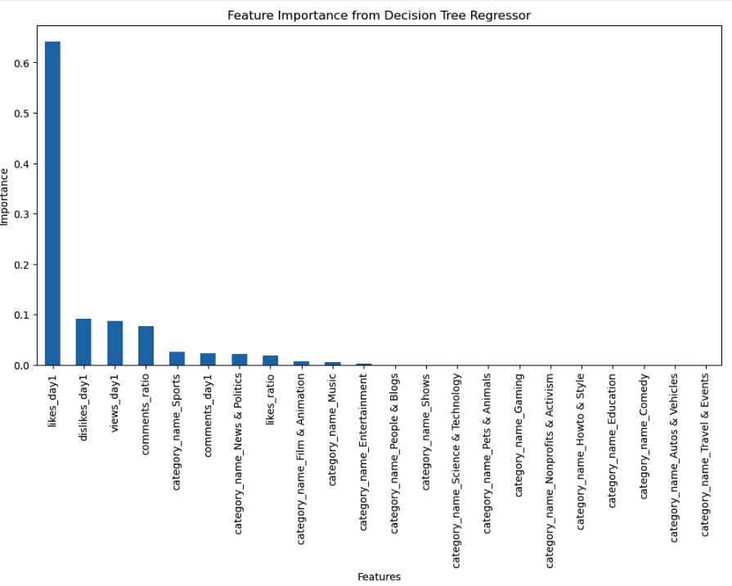
Decision Tree

Slide 21
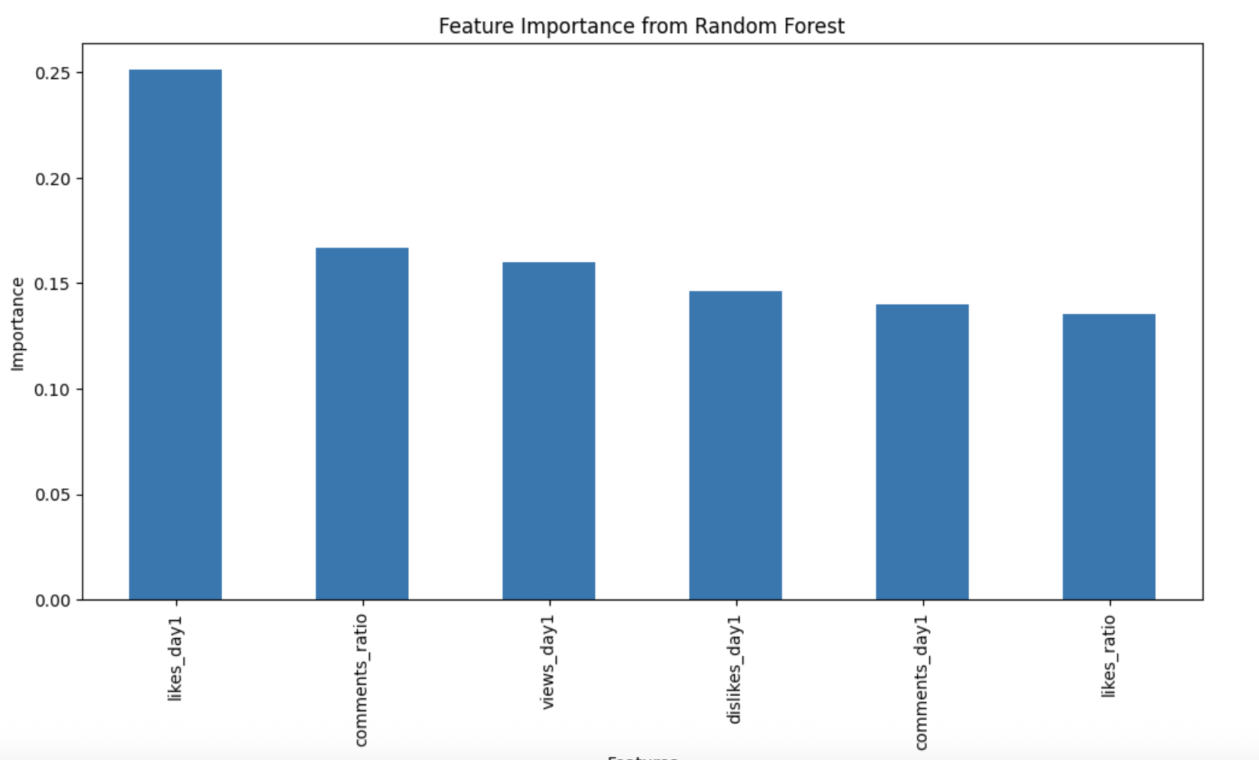
Random Forest
The parameters used for this model are n_estimators defined as 100. This model was evaluated using R2 and MSE.
Random Forest Regression Results:
MSE: 9.5561
Lower prediction errors
R²: 0.4328
Fits data better

Slide 22
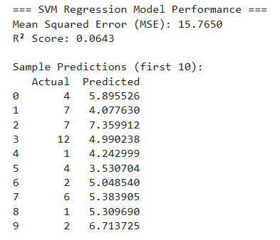
Machine Learning-SVM
Mean Squared Error (MSE): 15.7650
R² Score: 0.0643

Slide 23
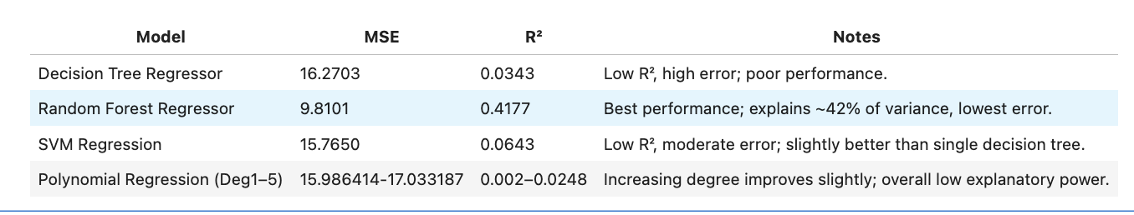
Model Comparison
Best-performing model: Random Forest Regressor
Its advantage lies in leveraging an ensemble of multiple decision trees to capture nonlinear relationships and reduce overfitting, making Random Forest the best-performing model among the four.

Slide 24
Stage IV

Slide 25
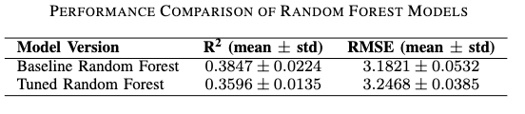
Model Validation
The random forest model showed the best regression results according to R-squared and RMSE.
We now use 5-fold cross validation to check whether this model generalizes well on different splits of data.
Performed hyperparameter tuning on this model.
The parameters n estimators: [100,200, 300], max depth: [None, 10, 20], min samples split: [2, 5], and max features: [’sqrt’, ’log2’]
The model selected the best parameters to be n estimators: 300, max depth: None, min samples split: 2, and max_features: sqrt.

Slide 26
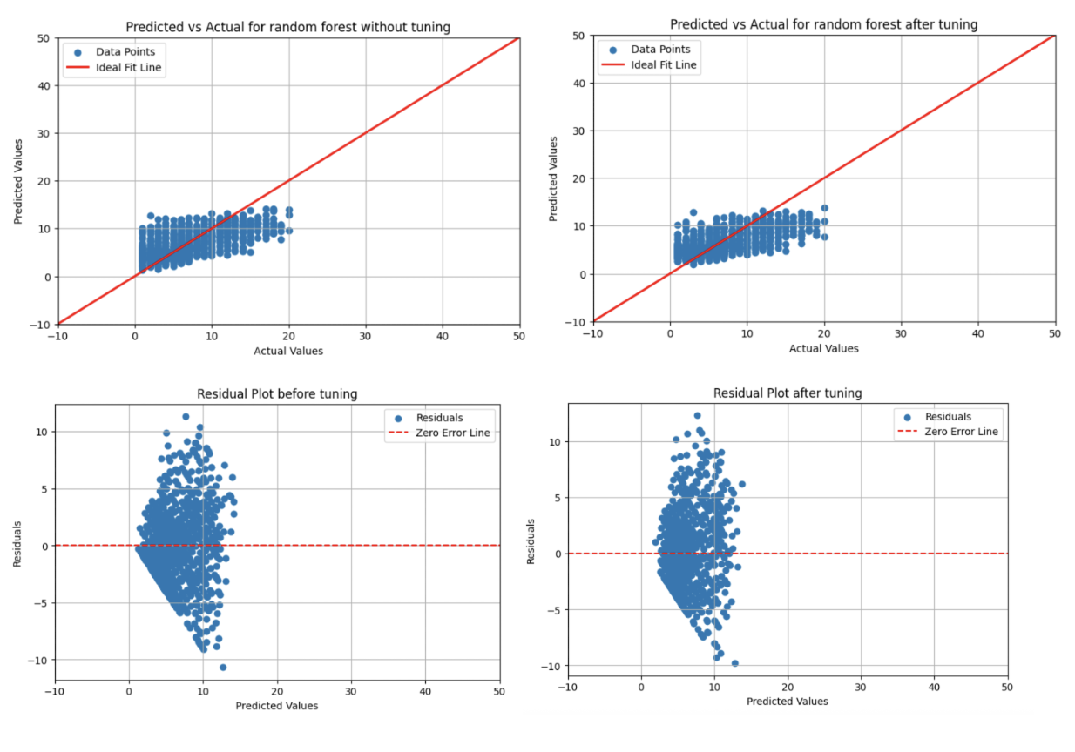
Model Visualization

Slide 27
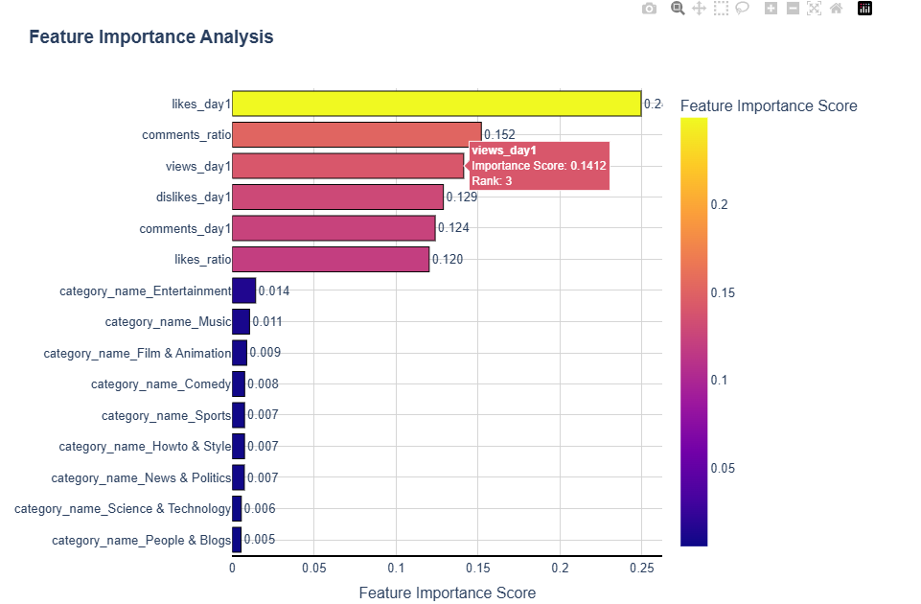
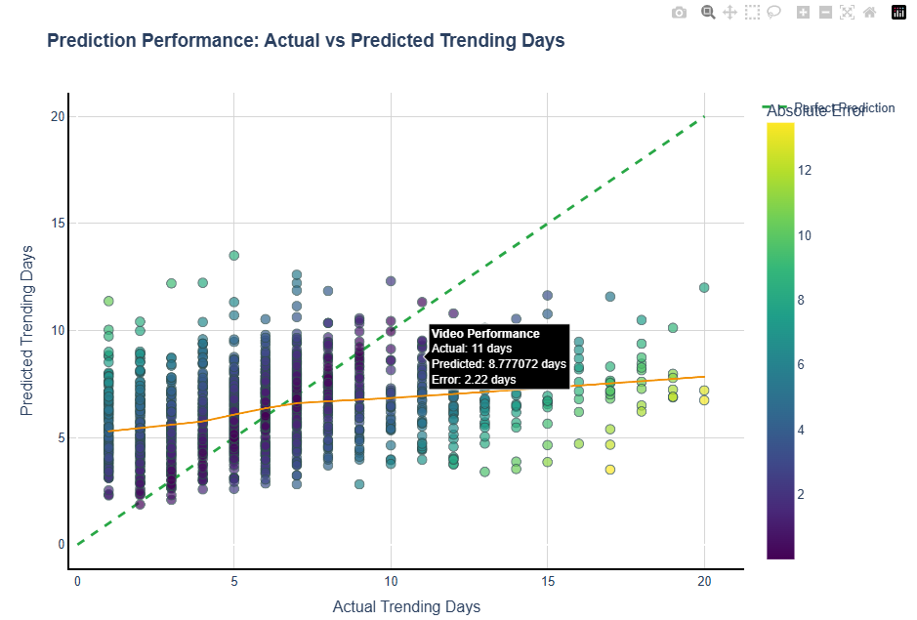
Interactive

Slide 28
Future Work
Experiment using advanced strategies like Bootstrap Aggregation (bagging), Boosting, random subspace method for better performance.
Perform Feature Engineering to include more features.

Slide 29
Thank you for listening!
Questions?

